Slide 2
—
App Vision
FOR anyone who buys their own food: Homemakers, couples, housemates etc.
WHO have a difficult time remembering all the things they need to buy / do
THE shopping Basket app IS An organizer that helps you remember what you need to buy and your favourite products
THAT allows you to upload pictures and locate the nearest supermarket
UNLIKE other apps, it’s not full of ads and also includes a to-do list
OUR PRODUCT helps you keep your busy life in order

Slide 3
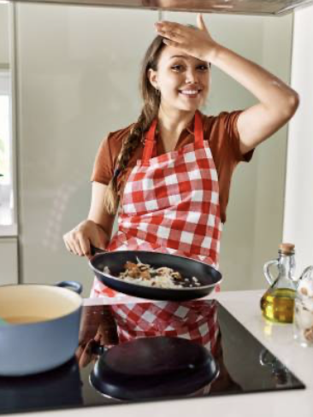
—
Persona
Background
Likelihood of engagement
Past experience: BB Homemaker keeps losing that piece of paper she takes to the shops or forgets what she needs to buy altogether.
Values: She is particular about the products she buys
Motivation: Hates getting home to find she forgot to buy half the things she set out to get.
BB will engage because:
She can add the items she wants to buy in a list and check them as she goes
The app is easy to use and up to date with store locations
Add photo here of person who represents your persona
Biography
Name:
BB Homemaker
Age:
35
Location:
Melbourne
Demographics
Engagement obstacles
BB and her husband own their own home in the suburbs
BB wont engage if:
The app is complicated and takes time to get used to
Is tricky to find
Goals and aspirations
BB is busy between social outings and running her home so wants to be better organized.

Slide 4
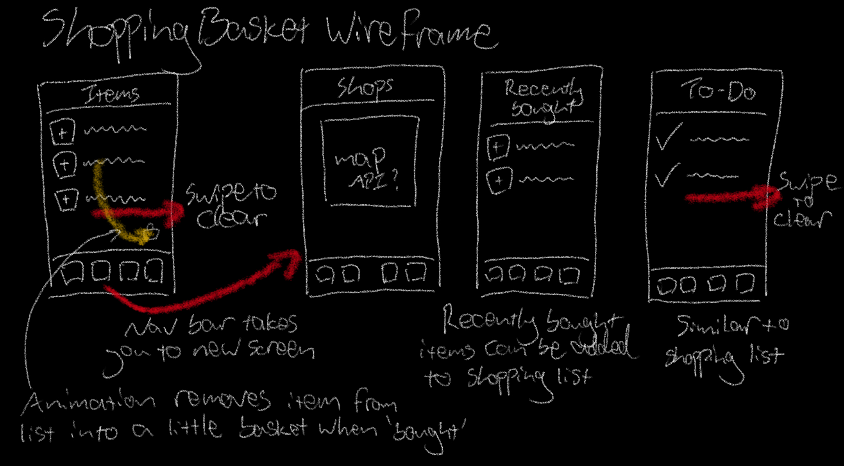
Wireframe

Slide 5
Wireframe – Potential additional features
Editable list for shopping items and to-do list
Can add photos to list items
Recently bought items can be added to list
Store locator – Google Places API
Save favourites
Access to wallet
Share list function – create user group accounts

